Slide 1
CSS

Slide 2
CSS is used to control the style of a web document in a simple and easy way.
CSS stands for Cascading Style Sheets
CSS handles the look and feel part of a web page.
Styles are normally saved in external .css files.

Slide 3
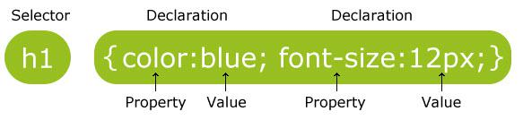
A CSS rule set consists of a selector and a declaration block:
The selector points to the HTML element you want to style.
The declaration block contains one or more declarations separated by semicolons.
Each declaration includes a property name and a value, separated by a colon.

Slide 4
A CSS declaration always ends with a semicolon, and declaration groups are surrounded by curly braces:
p {
color:red;
text-align:center;
}
CSS Comments
Comments are used to explain your code, and may help you when you edit the source code at a later date.
Comments are ignored by browsers.
A CSS comment starts with /* and ends with */ .
Comments can also span multiple lines:

Slide 5
CSS Selectors
CSS selectors allow you to select and manipulate HTML element(s).
CSS selectors are used to "find" (or select) HTML elements based on their id, classes, types, attributes, values of attributes and much more.
Mainly we use 3 types of selector:
Element selector
Id selector
Class selector
The element Selector
The element selector selects elements based on the element name.

Slide 6
You can select all <p> elements on a page like this: (all <p> elements will be center-aligned, with a red text color)
Example
<!DOCTYPE html>
<html>
<head>
<style>
p {
text-align: center;
color: red;
}
</style>
</head>
<body>
<p>Every paragraph will be affected by the style.</p>
<p id="para1">Me too!</p>
<p>And me!</p>
</body>
</html>
Result:
Every paragraph will be affected by the style.
Me too!
And me!

Slide 7
The id Selector
The id selector uses the id attribute of an HTML tag to find the specific element.
An id should be unique within a page, so you should use the id selector when you want to find a single, unique element.
To find an element with a specific id, write a hash # character, followed by the id of the element.
Example
The style rule below will be applied to the HTML element with id="para1":

Slide 8
<!DOCTYPE html>
<html>
<head>
<style>
#para1 {
text-align: center;
color: red;
}
</style>
</head>
<body>
<p id="para1">Hello World!</p>
<p>This paragraph is not affected by the style.</p>
</body>
</html>
Result:
Hello World!
This paragraph is not affected by the style.

Slide 9
The class Selector
The class selector finds elements with the specific class.
The class selector uses the HTML class attribute.
To find elements with a specific class, write “ . “symbol, followed by the name of the class:
In the example below,
all HTML elements with class="center" will be center-aligned:

Slide 10
<!DOCTYPE html>
<html>
<head>
<style>
.center {
text-align: center;
color: red;
}
</style>
</head>
<body>
<h1 class="center">Red and center-aligned heading</h1>
<p class="center">Red and center-aligned paragraph.</p>
</body>
</html>
Result:
Red and center-aligned heading
Red and center-aligned paragraph.

Slide 11
Grouping Selectors
In style sheets there are often elements with the same style:
h1 {
text-align: center;
color: red;
}
h2 {
text-align: center;
color: red;
}
p {
text-align: center;
color: red;
}
To minimize the code, you can group selectors.

Slide 12
To group selectors, separate each selector with a comma.
In the example below we have grouped the selectors from the code above:
<!DOCTYPE html>
<html>
<head>
<style>
h1, h2, p {
text-align: center;
color: red;
}
</style>
</head>
<body>
<h1>Hello World!</h1>
<h2>Smaller heading!</h2>
<p>This is a paragraph.</p>
</body>
</html>
Result
Hello World
Smaller heading!
This is a paragraph.

Slide 13
CSS are classified into three;
External stylesheet
Internal stylesheet
Inline stylesheet
External Style Sheet
An external style sheet is ideal when the style is applied to many pages.
With an external style sheet, you can change the look of an entire Web site by changing just one file.
Each page must include a link to the style sheet with the <link> tag.
The <link> tag goes inside the head section:

Slide 14
<head>
<link rel="stylesheet" type="text/css" href="mystyle.css">
</head>
An external style sheet can be written in any text editor.
The file should not contain any html tags.
The style sheet file must be saved with a .css extension.
An example of a style sheet file called "myStyle.css", is shown below:
body {
background-color: lightblue;
}
h1 {
color: navy;
margin-left: 20px;
}

Slide 15
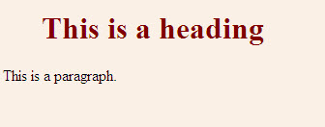
Internal Style Sheet
An internal style sheet should be used when a single document has a unique style. You define internal styles in the head section of an HTML page, inside the <style> tag, like this:
Example
<!DOCTYPE html>
<html>
<head>
<style>
body {
background-color: linen;
}
h1 {
color: maroon;
margin-left: 40px;
}
</style>
</head>
<body>
<h1>This is a heading</h1>
<p>This is a paragraph.</p>
</body>
</html>
Result

Slide 16
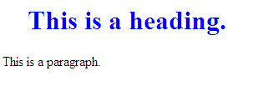
Inline Styles
An inline style loses many of the advantages of a style sheet (by mixing content with presentation).
To use inline styles, add the style attribute to the relevant tag.
The style attribute can contain any CSS property.
The example shows how to change the color and the left margin of a h1 element:
Example
<!DOCTYPE html>
<html>
<body>
<h1 style="color:blue;margin-left:30px;">This is a heading.</h1>
<p>This is a paragraph.</p>
</body>
</html>

Slide 17
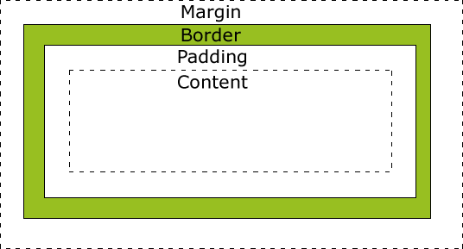
An inline style (inside an HTML element) has the highest priority, which means that it will override a style defined inside the <head> tag, or in an external style sheet.
The CSS Box Model
All HTML elements can be considered as boxes.

Slide 18
The CSS box model is essentially a box that wraps around every HTML element.
It consists of: margins, borders, padding, and the actual content.
Explanation of the different parts:
Content - The content of the box, where text and images appear
Padding - Clears an area around the content. The padding is transparent
Border - A border that goes around the padding and content.
Margin - Clears an area outside the border. The margin is transparent

Slide 19
Margin
The margin clears an area around an element (outside the border). The margin does not have a background color, and is completely transparent.
The top, right, bottom, and left margin can be changed independently using separate properties.
A shorthand margin property can also be used, to change all margins at once.

Slide 20
The margin property can have from one to four values.
margin: 25px 50px 75px 100px;
top margin is 25px
right margin is 50px
bottom margin is 75px
left margin is 100px
margin: 25px 50px 75px;
top margin is 25px
right and left margins are 50px
bottom margin is 75px
margin: 25px 50px;
top and bottom margins are 25px
right and left margins are 50px
margin: 25px;
all four margins are 25px

Slide 21
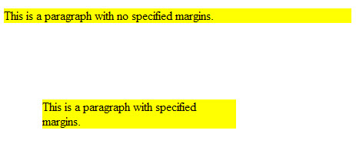
Margin - Individual sides
In CSS, it is possible to specify different margins for different sides of an element:
Example
<!DOCTYPE html>
<html>
<head>
<style>
p {
background-color: yellow;
}
p.ex {
margin-top: 100px;
margin-bottom: 100px;
margin-right: 150px;
margin-left: 50px;
}
</style>
</head>
<body>
<p>This is a paragraph with no specified margins.</p>
<p class="ex">This is a paragraph with specified margins.</p>
</body>
</html>
Result

Slide 22
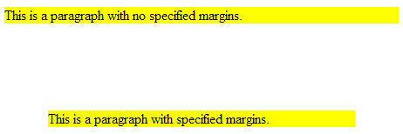
Margin - Shorthand property
To shorten the code, it is possible to specify all the margin properties in one property. This is called a shorthand property.
The shorthand property for all the margin properties is "margin":
Example
<!DOCTYPE html>
<html>
<head>
<style>
p {
background-color: yellow;
}
p.ex {
margin: 100px 50px;
}
</style>
</head>
<body>
<p>This is a paragraph with no specified margins.</p>
<p class="ex">This is a paragraph with specified margins.</p>
</body>
</html>
Result

Slide 23
Padding
The padding clears an area around the content (inside the border) of an element.
The padding is affected by the background color of the element.
The top, right, bottom, and left padding can be changed independently using separate properties.
A shorthand padding property can also be used, to change all paddings at once.

Slide 24
Border
The CSS border properties allow you to specify the style, width, and color of an element's border.
Border Style
The border-style property specifies what kind of border to display.
The following values are allowed:
dotted - Defines a dotted border
dashed - Defines a dashed border
solid - Defines a solid border
double - Defines a double border
groove - Defines a 3D grooved border. The effect depends on the border-color value
ridge - Defines a 3D ridged border. The effect depends on the border-color value
inset - Defines a 3D inset border. The effect depends on the border-color value
outset - Defines a 3D outset border. The effect depends on the border-color value
none - Defines no border
hidden - Defines a hidden border
The border-style property can have from one to four values (for the top border, right border, bottom border, and the left border).

Slide 25
Border Width
The border-width property specifies the width of the four borders.
The width can be set as a specific size (in px, pt, cm, em, etc) or by using one of the three pre-defined values: thin, medium, or thick.
Border Color
The border-color property is used to set the color of the four borders.
The border property is a shorthand property for the following individual border properties:
border-width
border-style (required)
Border-color
example
p {
border: 5px solid red;
}

Slide 26
There are four different combinators in CSS:
descendant selector (space)
child selector (>)
adjacent sibling selector (+)
general sibling selector (~)
13/08/16

Slide 27
Child Selector
The child selector selects all elements that are the immediate children of a specified element.
div > p {
background-color: yellow;
}
Adjacent Sibling Selector
The adjacent sibling selector selects all elements that are the adjacent siblings of a specified element.
Sibling elements must have the same parent element, and "adjacent" means "immediately following" .
div + p {
background-color: yellow;
}

Slide 28
General Sibling Selector
The general sibling selector selects all elements that are siblings of a specified element.
div ~ p {
background-color: yellow;
}
CSS Height and Width Dimensions
The CSS dimension properties allow you to control the height and width of an element.
The height and width properties are used to set the height and width of an element.
The height and width can be set to auto (this is default. Means that the browser calculates the height and width), or be specified in length values, like px, cm, etc., or in percent (%) of the containing block.

Slide 29
The position Property
The position property specifies the type of positioning method used for an element.
There are four different position values:
static
relative
fixed
Absolute
position: static;
HTML elements are positioned static by default.
Static positioned elements are not affected by the top, bottom, left, and right properties.
An element with position: static; is not positioned in any special way; it is always positioned according to the normal flow of the page:

Slide 30
Example
div.static {
position: static;
border: 3px solid #73AD21;
}
position: relative;
An element with position: relative; is positioned relative to its normal position.
Setting the top, right, bottom, and left properties of a relatively-positioned element will cause it to be adjusted away from its normal position.
Other content will not be adjusted to fit into any gap left by the element.
div .relative {
position: relative;
left: 30px;
border: 3px solid #73AD21;
}

Slide 31
position: fixed;
An element with position: fixed; is positioned relative to the viewport, which means it always stays in the same place even if the page is scrolled.
The top, right, bottom, and left properties are used to position the element.
A fixed element does not leave a gap in the page where it would normally have been located.
div.fixed {
position: fixed;
bottom: 0;
right: 0;
width: 300px;
border: 3px solid #73AD21;
}

Slide 32
position: absolute;
An element with position: absolute; is positioned relative to the nearest positioned ancestor (instead of positioned relative to the viewport, like fixed).
However; if an absolute positioned element has no positioned ancestors, it uses the document body, and moves along with page scrolling.
div.relative {
position: relative;
width: 400px;
height: 200px;
border: 3px solid #73AD21;
}
div.absolute {
position: absolute;
top: 80px;
right: 0;
width: 200px;
height: 100px;
border: 3px solid #73AD21;
}

Slide 33
Floating in CSS
The float property specifies whether or not an element should float.
img {
float: right;
margin: 0px 0px 10px 10px;
}
The clear property is used to control the behavior of floating elements.
Elements after a floating element will flow around it. To avoid this, use the clear property.
The clear property specifies on which sides of an element floating elements are not allowed to float:
div {
clear: left;
}

Slide 34
Hide an Element - display:none or visibility:hidden
Hiding an element can be done by setting the display property to none.
The element will be hidden, and the page will be displayed as if the element is not there:
h1.hidden {
display: none;
}
visibility:hidden; also hides an element.
However, the element will still take up the same space as before.
The element will be hidden, but still affect the layout:
h1.hidden {
visibility: hidden;
}

Slide 35
Pseudo-classes
A pseudo-class is used to define a special state of an element.
For example, it can be used to:
Style an element when a user mouses over it
Style visited and unvisited links differently
Style an element when it gets focus
The syntax of pseudo-classes:
selector:pseudo-class {
property:value;
}

Slide 36
/* unvisited link */
a:link {
color: green;
}
/* visited link */
a:visited {
color: yellow;
}
/* mouse over link */
a:hover {
color: violet;
}
/* selected link */
a:active {
color:red;
}

Slide 37
Pseudo-Elements
A CSS pseudo-element is used to style specified parts of an element.
For example, it can be used to:
Style the first letter, or line, of an element
Insert content before, or after, the content of an element
The syntax of pseudo-elements:
selector::pseudo-element {
property:value;
}

Slide 38
The ::first-line Pseudo-element
The ::first-line pseudo-element is used to add a special style to the first line of a text.
p::first-line {
color: #ff0000;
font-variant: small-caps;
}
The ::first-letter Pseudo-element
The ::first-letter pseudo-element is used to add a special style to the first letter of a text.
p::first-letter {
color: #ff0000;
font-size: xx-large;
}

Slide 39
The ::before Pseudo-element
The ::before pseudo-element can be used to insert some content before the content of an element.
h1::before {
content: url(smiley.gif);
}
CSS - The ::after Pseudo-element
The ::after pseudo-element can be used to insert some content after the content of an element.
h1::after {
content: url(smiley.gif);
}

Slide 40
Image Opacity
The CSS3 property for transparency is opacity.
<html>
<head>
<style>
img {
opacity: 0.4;
filter: alpha(opacity=40); /* For IE8 and earlier */
}
</style>
</head>
<body>
<img src="klematis.jpg" width="150" height="113" alt="klematis">
</body>
</html>

